Slide 1
Tobacco policies in informal economies - Grand round presentation -
TOPS
Paul Rodríguez-Lesmes (Universidad del Rosario)

Slide 2
Disclosure
Funding sources
Global Alliance for Chronic Diseases (GADC) project from CIHR/IDRC [grant number 108442-001]
American Cancer Society (ACS) and Cancer Research-UK known as the Programme for Research, Advocacy and Capacity Building on Tobacco Taxation (PROACTT) under the grant #47437.
World Bank and Colombian Government - Alianza EFI 60185 contract FP44842- 220-2018 Colombia Científica (Informal economy)
Tobacco-related funding sources over last 10 years
None

Slide 3
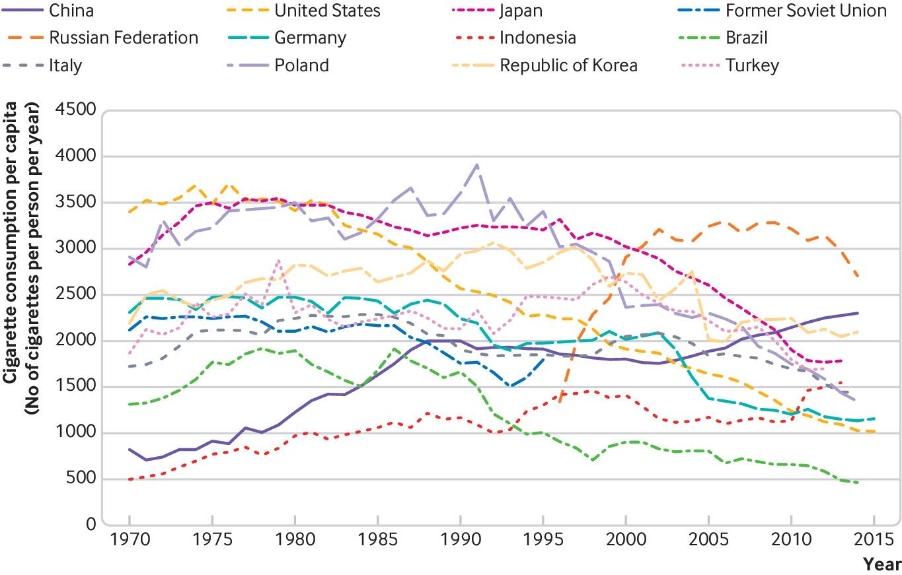
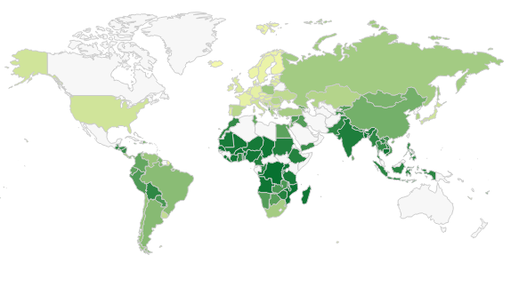
Tobacco policies in informal economies
There is a declining in trend in tobacco use in Western countries
WHO Framework Convention on Tobacco Control (FCTC)
But this is not the same for all countries >>
Middle-income countries tasks face difficulties due to their highly informal economies
Hoffman, S. J., Mammone, J., Van Katwyk, S. R., Sritharan, L., Tran, M., Al-Khateeb, S., ... & Poirier, M. J. (2019). Cigarette consumption estimates for 71 countries from 1970 to 2015: systematic collection of comparable data to facilitate quasi-experimental evaluations of national and global tobacco control interventions. bmj, 365.

Slide 4
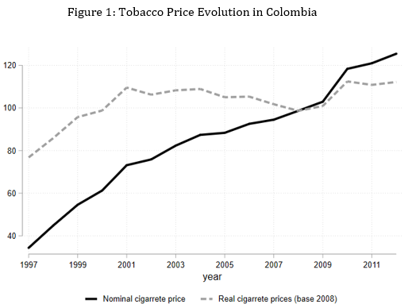
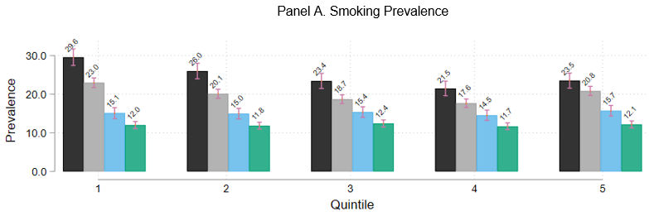
1. Taxes and crowding-out of human capital accumulation
Gallego, J; Paraje G; Rodriguez-Lesmes, P (Work in progress)
Informality is usually associated with low income levels
Rising taxes with an inelastic demand might result in poorer households (among the remaining smokers)
Lower levels of investment in health and education?
We consider the case of Colombia 1997 - 2011

Slide 5
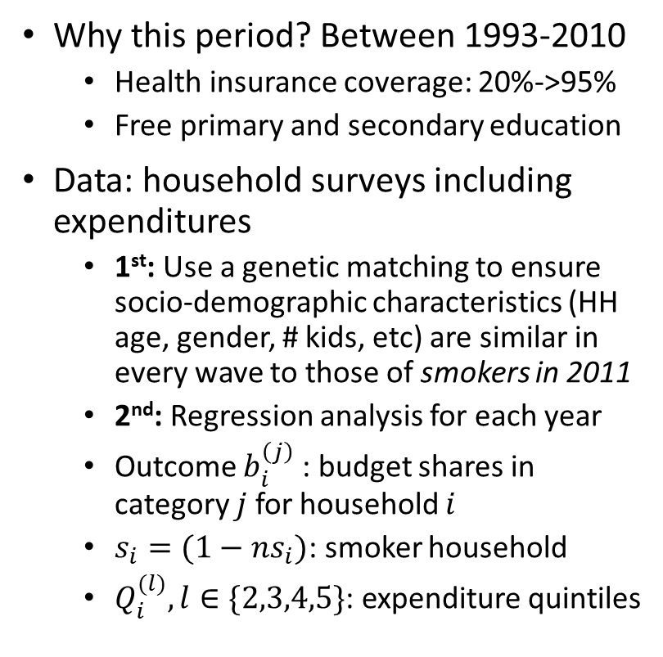
1. Taxes and crowding-out of human capital accumulation
Gallego, J; Paraje G; Rodriguez-Lesmes, P (Work in progress)
Why this period? Between 1993-2010
Health insurance coverage: 20%->95%
Free primary and secondary education
Data: household surveys including expenditures
1st: Use a genetic matching to ensure socio-demographic characteristics (HH age, gender, # kids, etc) are similar in every wave to those of smokers in 2011
2nd: Regression analysis for each year
Outcome $b_{i}^{\left(j\right)}$ : budget shares in category $j$ for household $i$
$s_{i}=(1−ns_{i})$: smoker household
$Q_{i}^{(l)}, l∈\{2,3,4,5\}$: expenditure quintiles
Are they different? >> Crowding-out quintile 1
Are they different? >> Inequality

Slide 6
1. Taxes and crowding-out of human capital accumulation
Gallego, J; Paraje G; Rodriguez-Lesmes, P (Work in progress)
Results and conclusions
Prior work has shown crowding-out effects on health, education, and even food consumption (Wang et al., 2006; John, 2008; Block and Webb, 2009)
In Colombia, between 1997 and 2011, prevalence halved, but the budget share for remaining smokers doubled
At the same time, there was a massive expansion of social policies: almost free access to health and education for the poorest households
We find
No evidence of a crowding-out in health and in food expenditures, neither in quintiles 1 or 5
Crowding-in of alcohol most years (a common finding)
Relatively lower budget shares in leisure and clothing for smokers than for smokers
Therefore, Colombia still had room to add more financial pressure on cigarettes as social policies protect human capital accumulation
Caveat: descriptive analysis, no exogenous variation on taxes or social policy

Slide 7
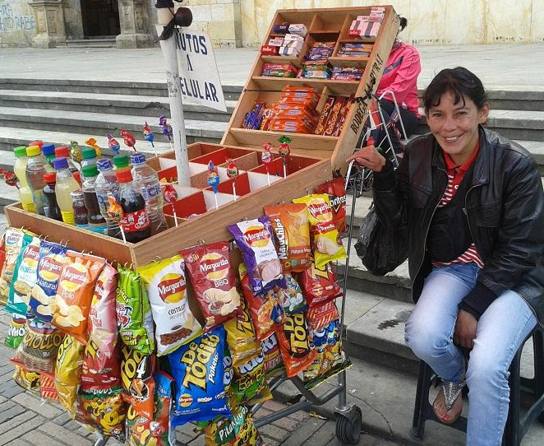
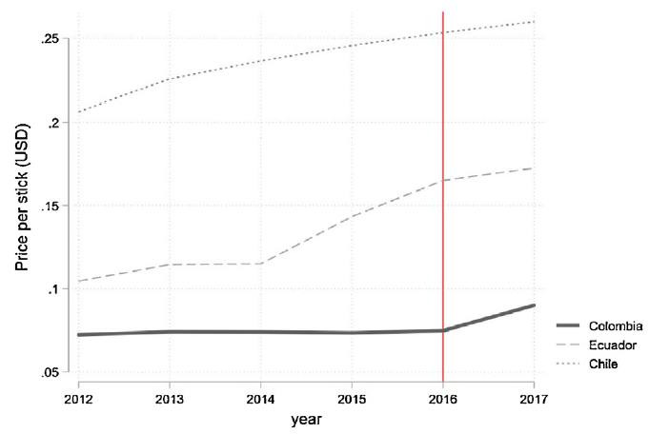
2. Tobacco taxes and illicit cigarette trade in Colombia
Gallego, J; Llorente, B; Maldonado, N; Otálvaro-Ramírez, S Rodriguez-Lesmes, P (2020). Economics & Human Biology, 39, 100902.
Higher taxes -> Higher levels of illicit trade
This is an old relationship, and a big threat in countries with large informal markets
Almost open international borders
Hard to control street vendors
Nearly impossible trace where the final product comes from
The tobacco industry exploit this argument to systematically overstate the size of informal markets
And to oppose any further tax hike (and even to propose its reduction)
In 2016, a major (but far from ‘desired’) tax hike was introduced in the country
By how much it increased illicit trade penetration?
Nearly 50% of cigarettes are sold by sticks
20-pack avg: 2950 COP (1USD)
New Excise tax: $700 COP
Images: left, Llorente et al. data field on measuring the size of the illicit market; rigth, Mayor of Bogotá

Slide 8
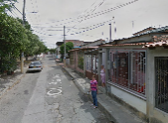
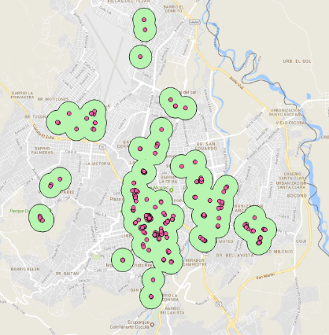
2. Tobacco taxes and illicit cigarette trade in Colombia
Gallego, J; Llorente, B; Maldonado, N; Otálvaro-Ramírez, S Rodriguez-Lesmes, P (2020). Economics & Human Biology, 39, 100902.
Data?
Illicit trade per se: no administrative or official data available
(one referee asked for high frequency data)
Maldonado et al. (2018) measured illicit trade penetration
Deics-Col 2016 and 2017 was collected in a panel of geographic locations, with an individual survey on those individuals found smoking in a given area
5 cities, which covers 63% of the market
Identification of illicit trade based on brand, package, and price (cannot be cheaper than the tax itself)
La Laguna neighborhood
City: Cúcuta
Green buffers: 2016
Violet dots: 2017
Estadium area

Slide 9
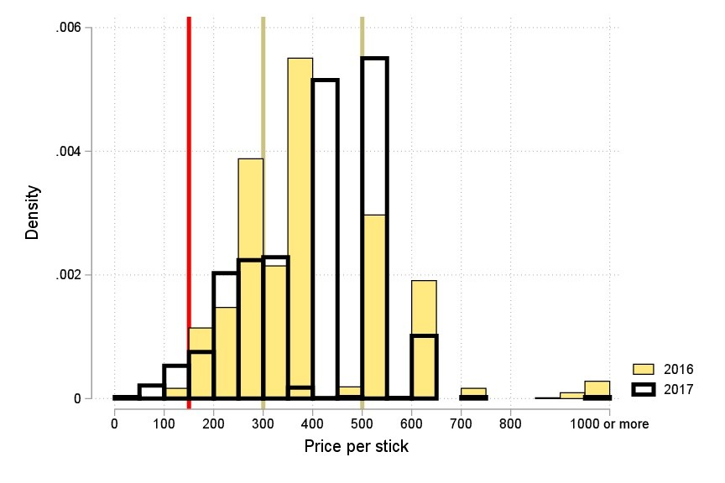
2. Tobacco taxes and illicit cigarette trade in Colombia
Gallego, J; Llorente, B; Maldonado, N; Otálvaro-Ramírez, S Rodriguez-Lesmes, P (2020). Economics & Human Biology, 39, 100902.
Causal effect?
Taxes are nation wide: no state-level comparisons
Other comparable countries have the same measurement issues as we do
How to get some sort of comparison?
This is a excise tax of 700 COP for every 20-cig pack, irrespective of its price
For ‘cheap’ cigarettes it is a lot
For expensive’ ones, is not so much
Thus, we expect a larger impact on illicit trade penetration in the ‘cheap’ relative to the ‘expensive’ segments
The ‘expensive’ segment should capture the general time trend
Most illicit cigarettes are very cheap, so they’ll compete with the currently ‘cheap’ cigarettes
Price variation?
The main source is not the brand (few of them)
It comes from place of purchase
Cheapest at huge retailer stores
Most expensive with street vendors, near bars and night clubs

Slide 10
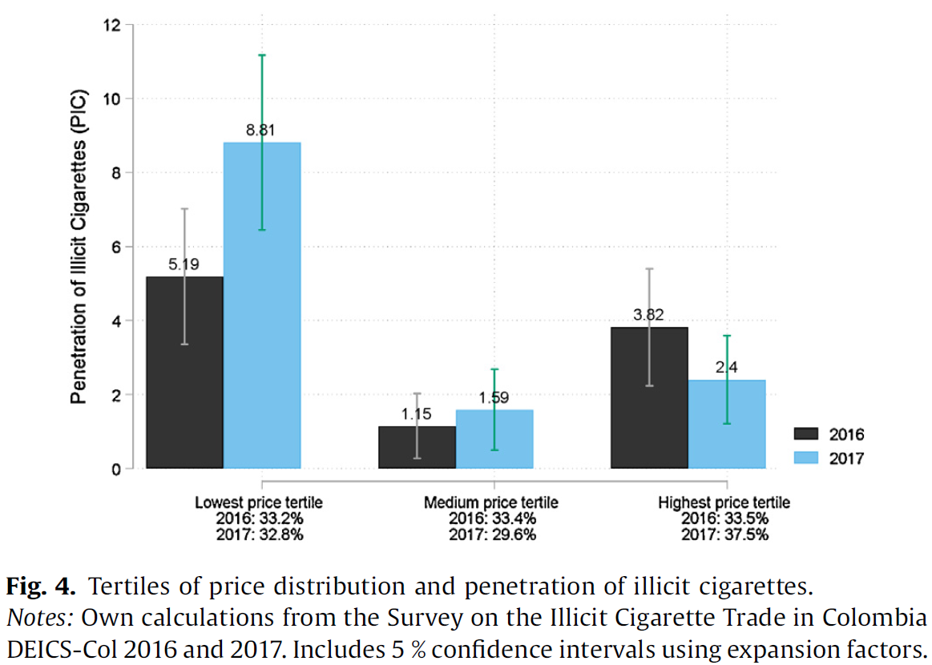
2. Tobacco taxes and illicit cigarette trade in Colombia
Gallego, J; Llorente, B; Maldonado, N; Otálvaro-Ramírez, S Rodriguez-Lesmes, P (2020). Economics & Human Biology, 39, 100902.
Method
DiD, where the control group is the highest price tertile $d=3$. Here $A_{t}=1$ in 2017
Outcome ($Y$): illicit trade penetration by smoker $i$
Individual controls, and geographic areas $j$ fixed effects
Results
Illicit trade penetration on the cheapest segment increase between 5.1 – 5.4 pp [p-val=0.07], from roughly 5% penetration in 2016
For the medium segment, no increase was found
Conclusion
Cigarette prices were still low, so it was safe to keep increasing taxes without fearing to loose control of the market

Slide 11
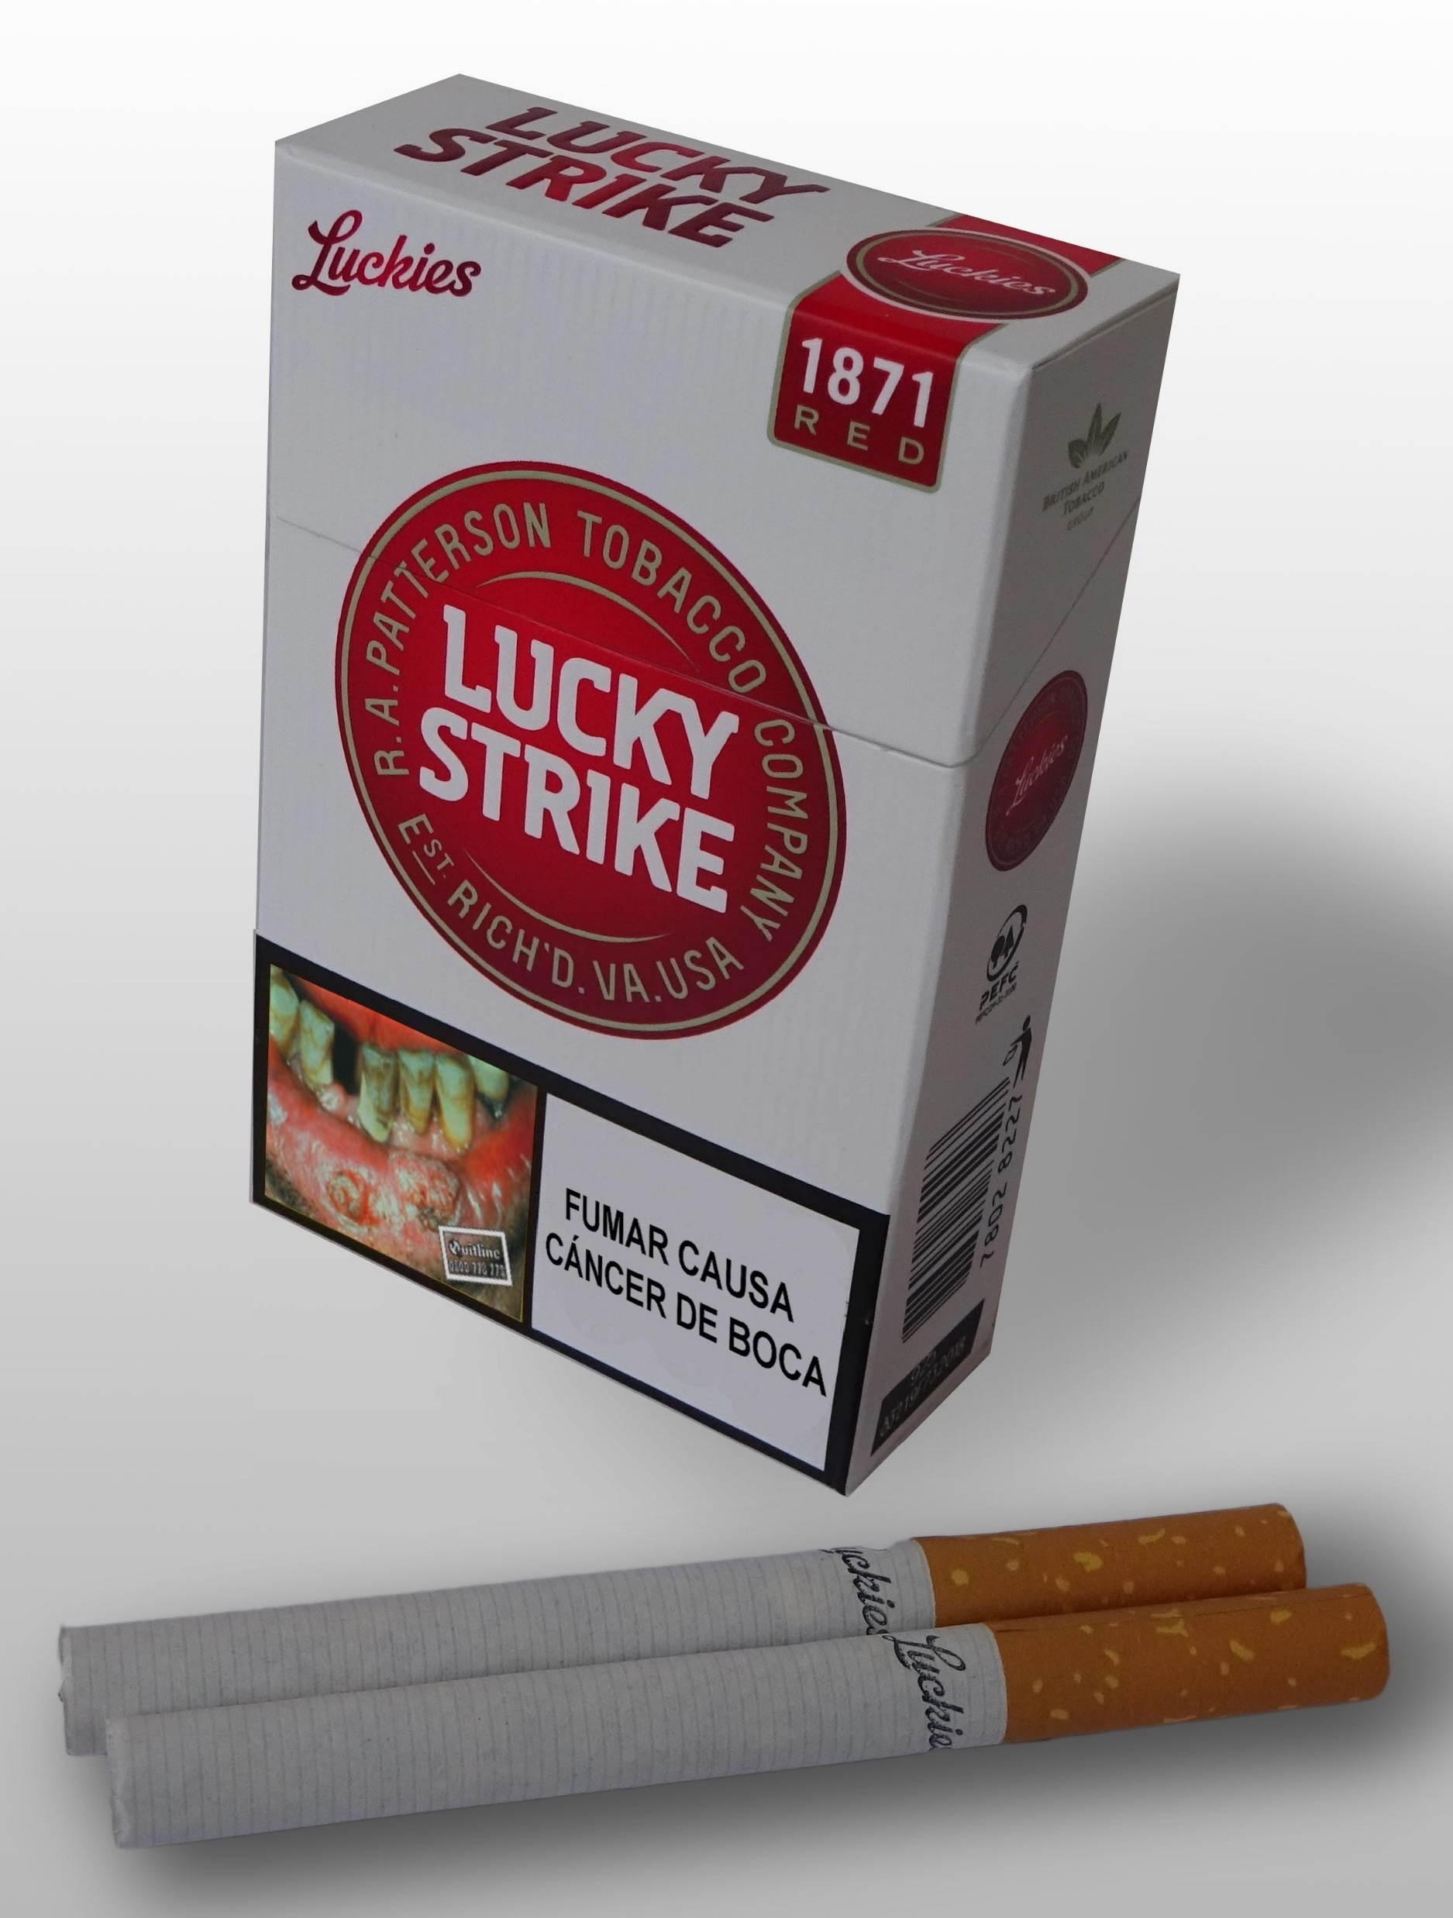
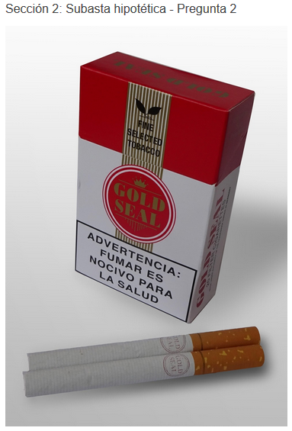
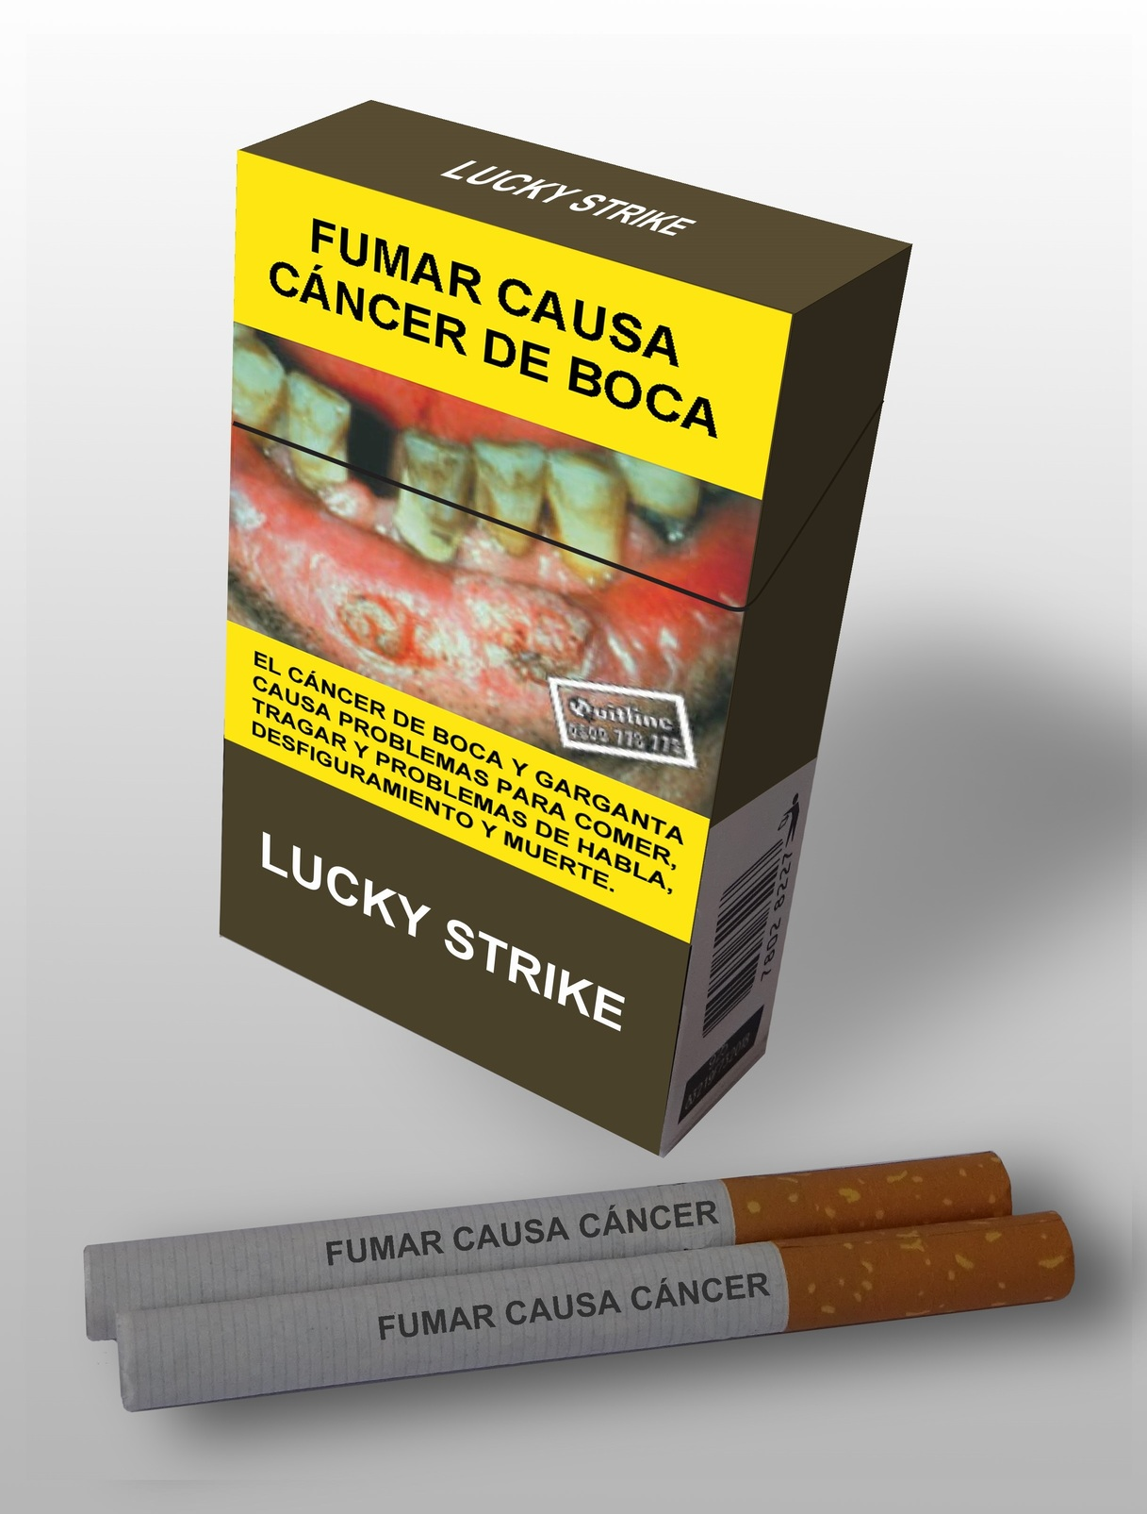
3. Plain package in MI countries
9000 COP
Guindon, E.; Mentzakis E.; Paraje, G; et al. – Work in progress -
A plain package is the desired standard
Yet, informal markets makes it a bit more complex
50% of sales occur at the street vendor level, almost all as sticks (package is not seen)
Illicit trade packs do not follow the rules, and are considerably cheaper
Goal: measure the value of plain packages in a set of medium income countries with a DCE
Chile
Colombia
Ecuador
South Africa
Vietnam
3000 COP

Slide 12
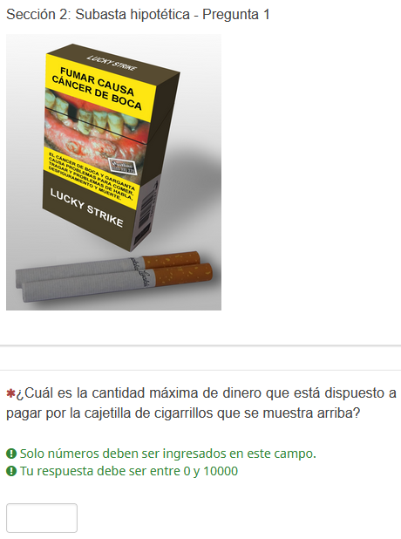
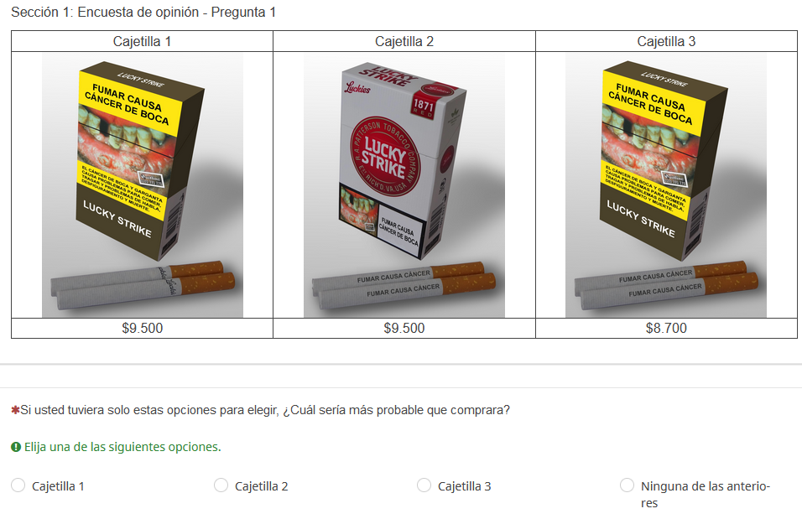
3. Plain package in MI countries
Guindon, E.; Mentzakis E.; Paraje, G; et al. – Work in progress -
Colombian version. Online task, N=1200
Based on the design and pilot in Canada
Includes
Smokers 18-45
Non-smokers 18-21
Design
Attributes:
Price: Three levels
Package: Plain, Standard
Cigarette: Branded, With warning
Illicit trade package: Two level prices
Blocks, each of 7 choices
Block 1: With illicit trade v1
Block 2: With illicit trade v2
Block 3: No illicit trade
Includes a hypothetical auction as an alternative measure

Slide 13
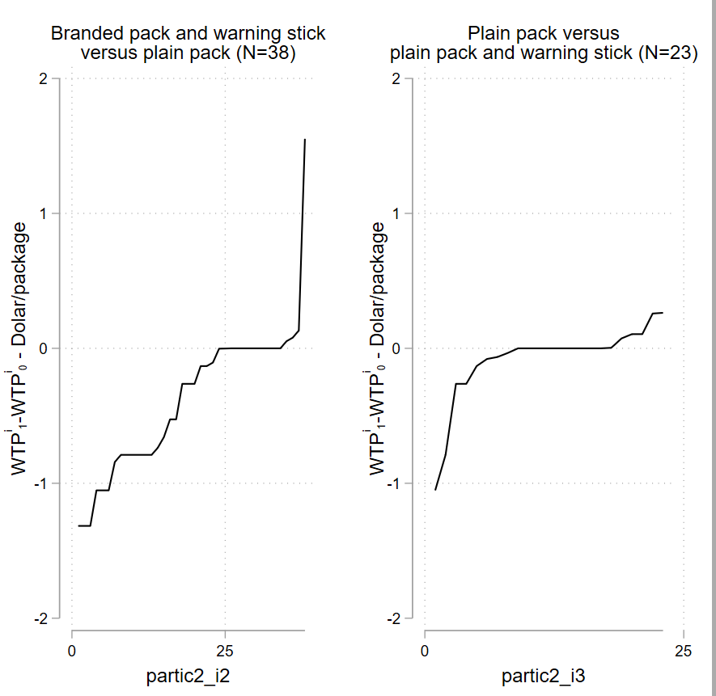
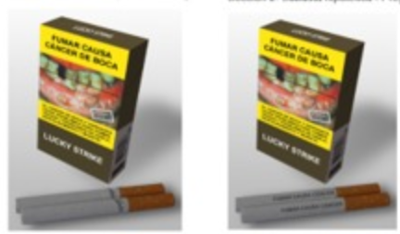
3. Plain package in MI countries
Guindon, E.; Mentzakis E.; Paraje, G; et al. – Work in progress -
Pilot results
Blocks 1 & 2, N=87 / Block 3, N=24, only smokers
Clogit estimates
Package usual price: 2.36 USD
WTP for the branded pack=3.89 USD *** / 2.57 USD
WTP for the warning stick=+0.2 USD* / + 0.07 USD
WTP for avoiding illicit trade? 0
Auction results
The value of branded package and warning stick compared to plain pack leads to higher variations
WTP variations of plain packages show fewer participants reacting
WTP to avoid plain package
Mean=-0.38
WTP to avoid the warning in the cigarette
Mean=-0.08

Slide 14
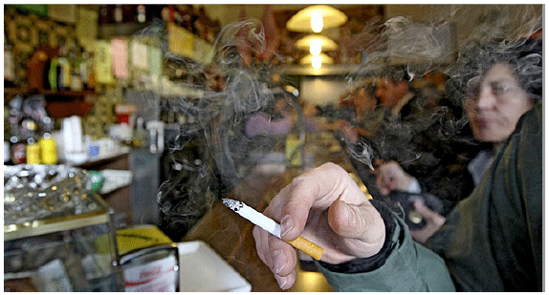
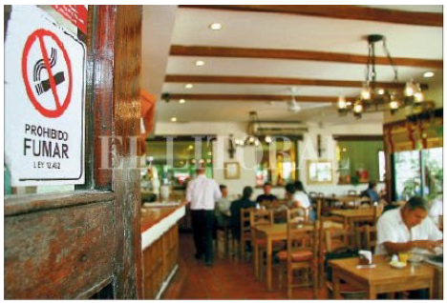
4. De-normalizing smoking in urban areas
Otálvaro-Ramírez, S; Gallego, J; Rodríguez-Lesmes, P. – Work in progress -
The FCTC includes command-and-control policies such public smoking bans
There is evidence that these policies works especially for the users of the places where the ban is in place
Colombia 2010: prohibition to smoke in bars and restaurants
How could these policies work in practice in LMICs?
Most bars and restaurants are small businesses, most of them part of the informal sector: “enforcement” of ANY regulation is not an easy task
In Colombia, on top of the law, there was an “agreement” between shop owners and the Ministry of Health to implement the ban. Anecdotally (no data on this), it worked.
How to estimate its effects of smoking prevalence?

Slide 15
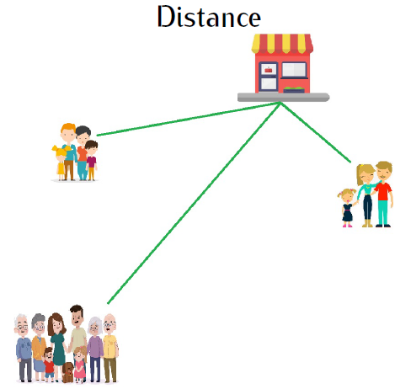
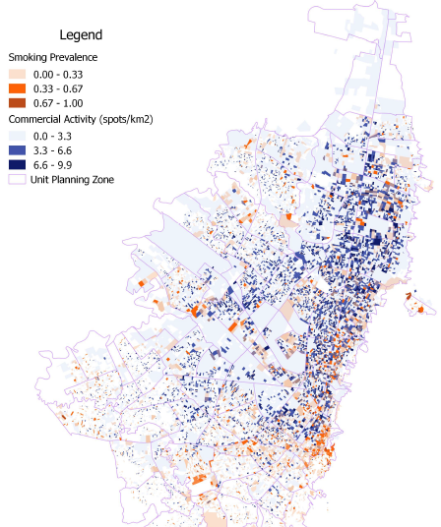
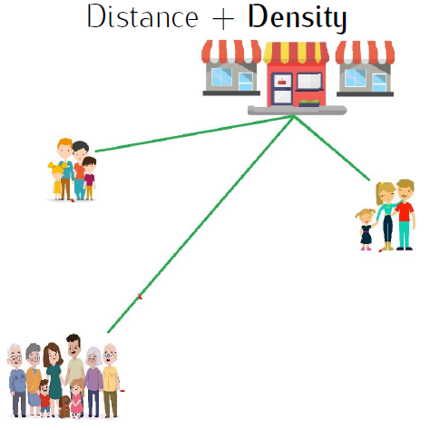
4. De-normalizing smoking in urban areas
Otálvaro-Ramírez, S; Gallego, J; Rodríguez-Lesmes, P. – Work in progress -
We exploit geographical proximity of households to commercial hot spots
Make use of large household surveys in Bogotá collected at block level (2008 and 2011), and a census of bars and restaurants
Match households based on their proximity to commercial hot-spots
Idea: Households closer to commercial areas with many bars and restaurants would perceive a notorious change on the “normality” of being a smoker
DiD strategy: Near vs Far
DDD: Near a high-density area vs Near a low-density ; relative to Far from a high-density area vs Far from a low-density

Slide 16
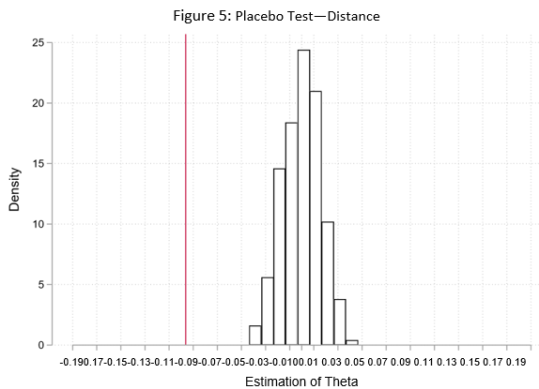
4. De-normalizing smoking in urban areas
Otálvaro-Ramírez, S; Gallego, J; Rodríguez-Lesmes, P. – Work in progress -
Results
There is no evidence that households located in blocks near to commercial areas experienced a reduction in smoking prevalence different to households far from them
Yet, if we consider the density of commercial areas (high vs low density, based on the median), there is a reduction on the prevalence of smoking of nearly 9.6 pp. (SE=4.6 pp)
No difference on the age of the HH
Households with kids under 5 react more (-13.4 pp)
Households with skilled HH react more (-11.2 pp)
Results are robust to definitions of “near” and “high-density”, and are significantly different to a similar analysis but under a random allocation of proximity variables (placebo)
Conclusion
The smoking ban did contribute to the reduction on prevalence
Note: Both distance and density are drawn from uniform distributions. Distance between 0 and 800 meters, and density between 0 and 5. This procedure was executed 500 times. The vertical line corresponds to the main point estimate.

Slide 17
Many thanks!
Paul Rodríguez-Lesmes, paul.rodriguez@urosario.edu.co
These projects include the participation of
Juan Miguel Gallego (Universidad del Rosario, Colombia)
Guillermo Paraje (U Adolfo Ibañez, Chile)
Emmanuel Guindon (McMaster, CA)
Susana Otálvaro-Ramirez (Universidad del Rosario, Colombia)
Leonel Criado (Universidad del Rosario, Colombia)
Blanca Llorente (Fundación Anaas)
Norman Maldonado (U. ICESI – PROESA, Colombia)
Tatiana Villacres (McMaster, CA)
Nicole Vellios (U Cape Town)
Emmanouil Mentzakis (U Southampton, UK)
Gioia Buckley (McMaster, CA)
Neil Buckley (McMaster, CA)

